Slide 1
Quantum Computing: Minimum Search by Groover algorithm
Lyakhov Daniil
MagIAD2020

Slide 2
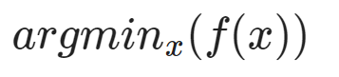
Problem definition:
Given function f: int -> int
Problem: argmin_{x}(f(x))

Slide 3
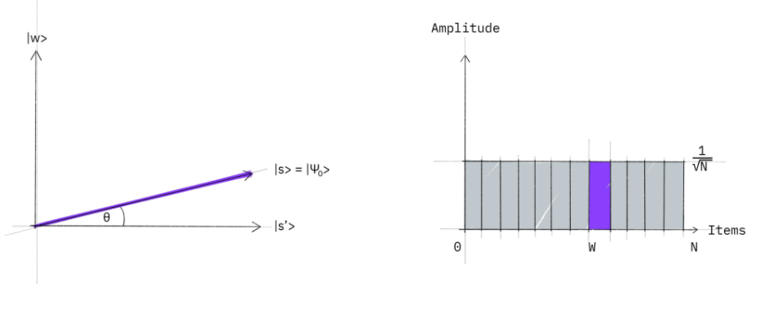
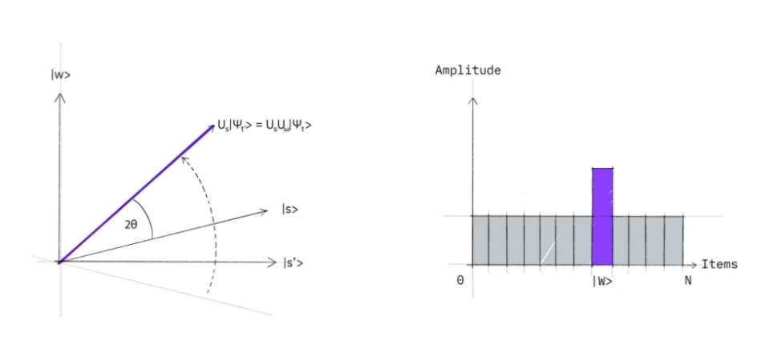
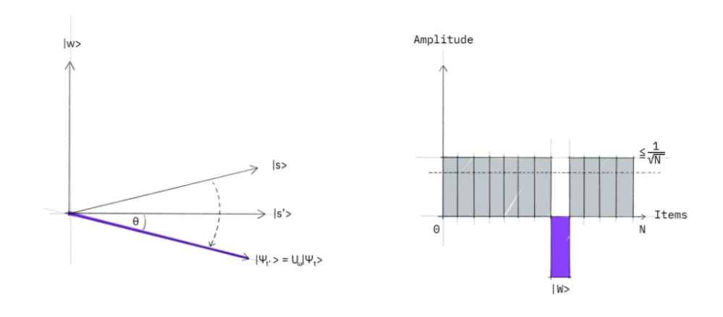
Pre Requirements: Groover Algorithm
Explanation: https://colab.research.google.com/drive/1cIusyX6rjEca-9UeBedZCenJ7H0MIoVC?usp=sharing

Slide 4
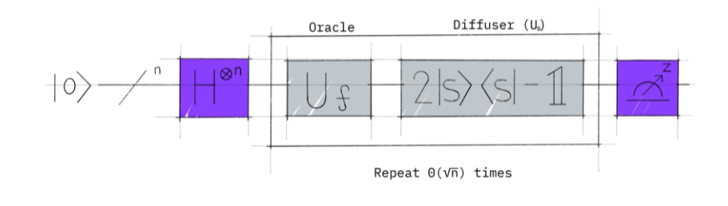
Pre Requirements: Groover Algorithm
Explanation: https://colab.research.google.com/drive/1cIusyX6rjEca-9UeBedZCenJ7H0MIoVC?usp=sharing

Slide 5
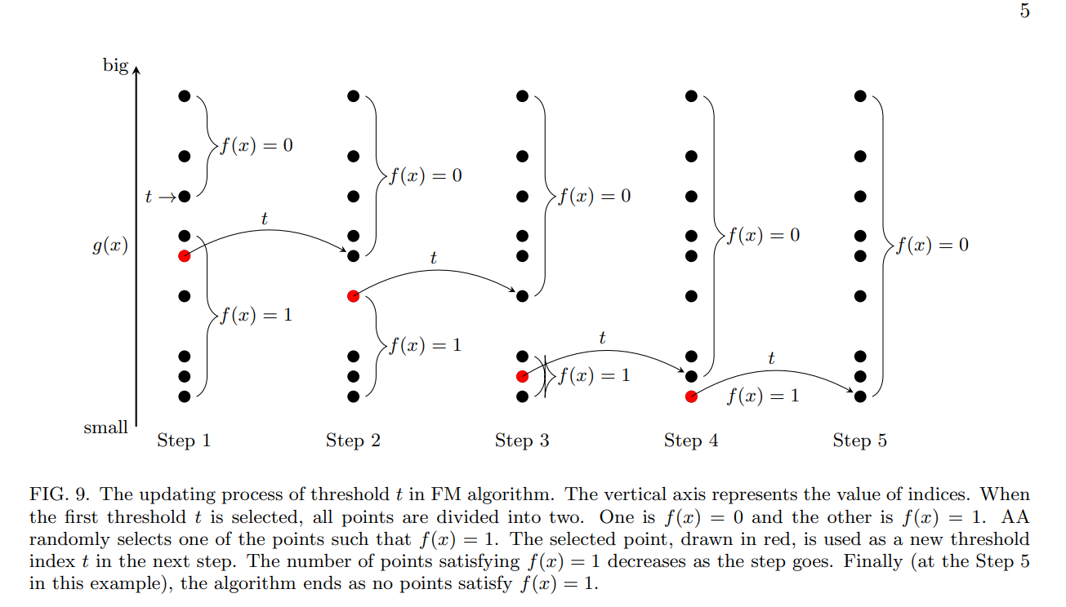
Argmin search
Arxiv https://arxiv.org/pdf/1907.03315.pdf

Slide 6
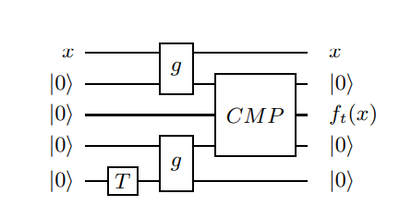
Special Oracle for Groover algorithm
Arxiv https://arxiv.org/pdf/1907.03315.pdf

Slide 7
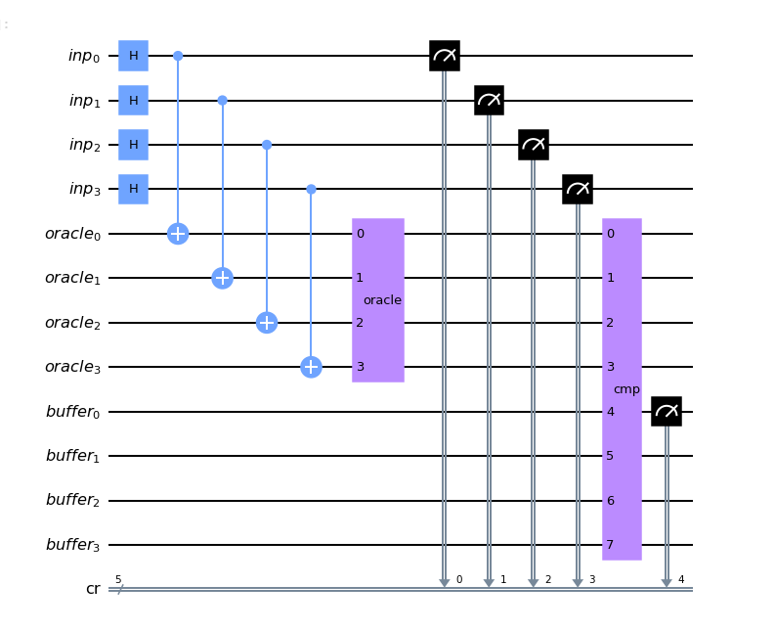
Bit Flip Oracle: Sampling

Slide 8
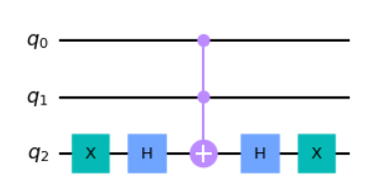
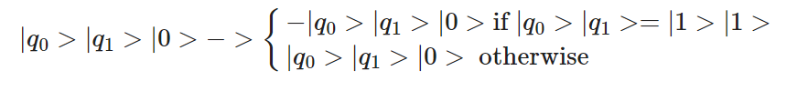
Convert Bit Flip Oracle to Phase Flip Oracle: Example
Oracle: Good State - (1,1)

Slide 9
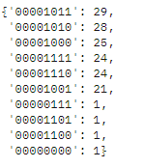
Results
Reference
Filtered algo output

Slide 10
Further Work - Quantium KNN
“One of the simplest and most effective classical machine learning algorithms is the k nearest neighbors algorithm (kNN) which classifies an unknown test state by finding the k nearest neighbors from a set of M train states. Here we present a quantum analog of classical kNN – quantum kNN (QkNN) – based on fidelity as the similarity measure. We show that the QkNN algorithm can be reduced to an instance of the quantum k maxima algorithm; hence the query complexity of QkNN is O( √ kM). The non-trivial task in this reduction is to encode the fidelity information between the test state and all the train states as amplitudes of a quantum state. Converting this amplitude encoded information to a digital format enables us to compare them efficiently, thus completing the reduction. Unlike classical kNN and existing quantum kNN algorithms, the proposed algorithm can be directly used on quantum data, thereby bypassing expensive processes such as quantum state tomography.”
https://arxiv.org/pdf/1907.03315.pdf -

